Slide 1
Group Project
Mohammad Bayat
Joanne Pyo
Akil Bhuiyan

Slide 2

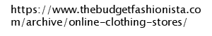
Goal
Our group predict that
if the demand for the product is high , the product price will be higher than the average price. If the price is higher, one will be put down and if the price is lower than the average, and then we will indicate it.

Slide 3
E-Shop Clothing
 | Variables | Description
1 | year | 2008.
2 | month | From April to August.
3 | day | Day number of the month.
4 | order | Sequence of clicks during one session.
5 | Country | Variable indicating the country of origin of the IP address with 42 different countries.
6 | session ID | Variable indicating session id.
7 | ProductCategory | Trousers, Skirts, Blouses, and Sale.
8 | ClothingModel | contains information about the code for each product (217 products).
9 | color | 14 different colors of product .
10 | Location | Photo location on the page, the screen has been divided into six parts.
11 | ModelPhoto | Variable with two categories: en face and profile.
12 | price | Price in US dollars.
13 | price 2 | Product is higher than the average price.
14 | Page | Page number within the e-store website (from 1 to 5).

Slide 4
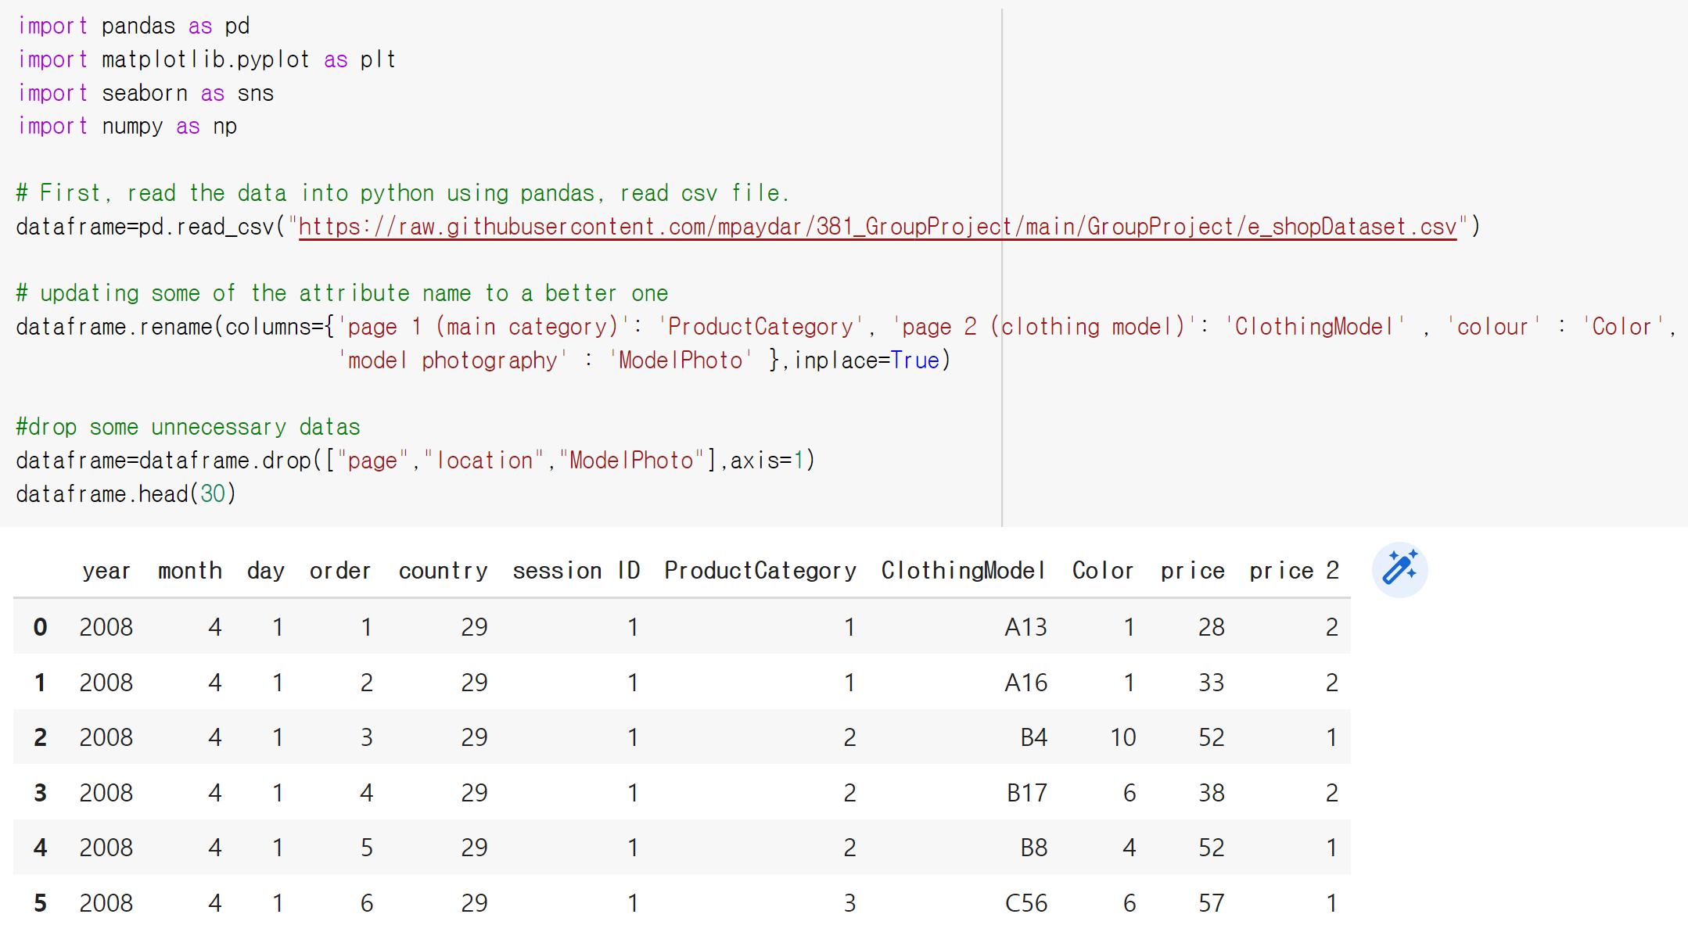
Initial Exploratory Data Analysis
Notes:
Delete unnecessary columns(datas) : page,location, and ModelPhoto.

Slide 5
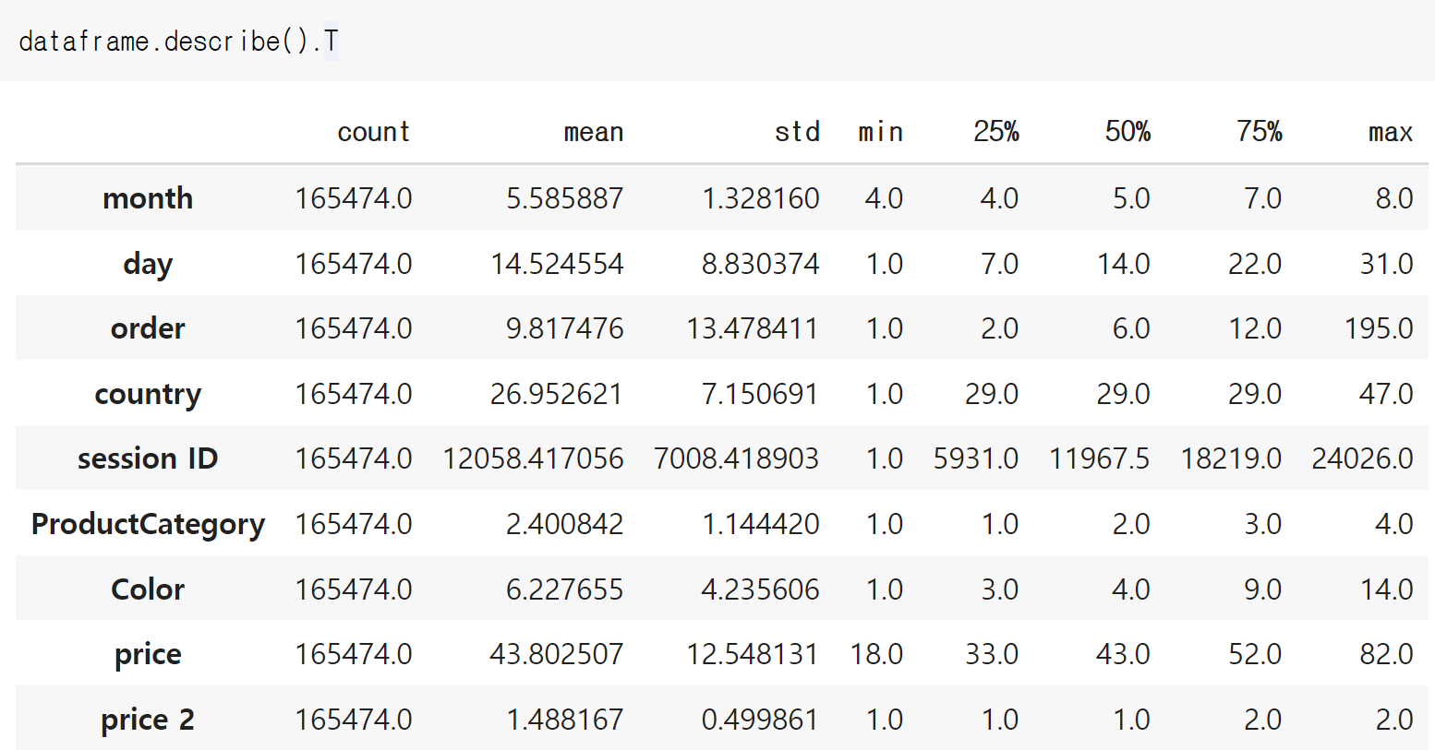
Describe data

Slide 6
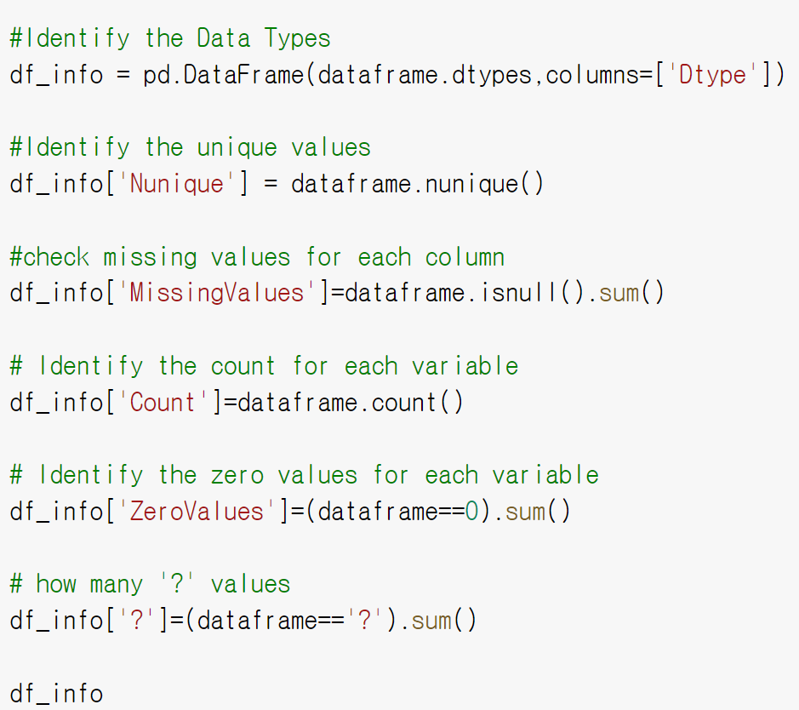
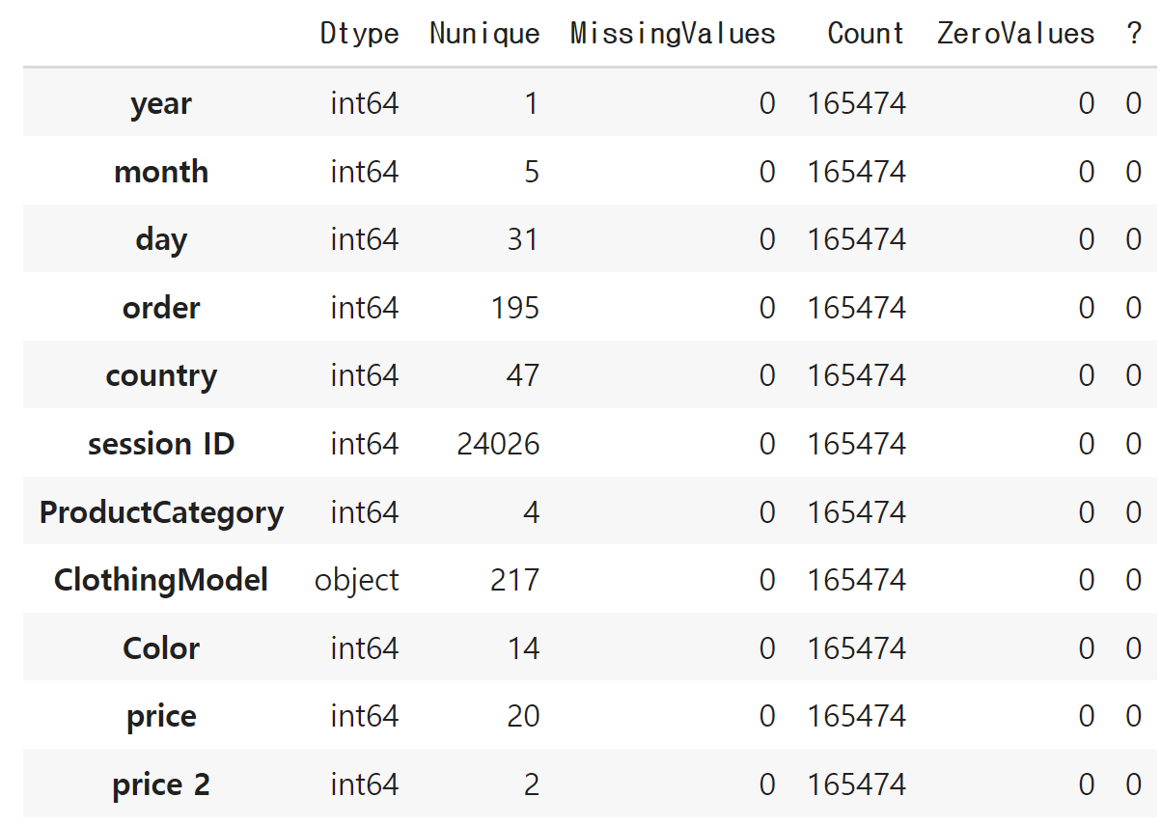
Identify the data type, unique , missing values, count , zero values, and ?
All the data seems to be from 2008 , so there is really no use of using year as it's not giving us any information. However, from the nunique output we could see that there are several distinct days and months which could give us an insight as we dig more down into data.

Slide 7
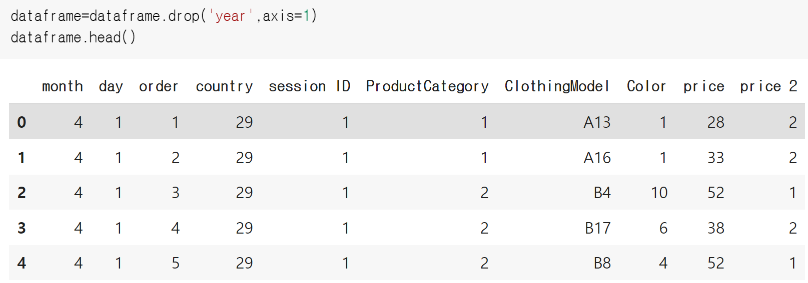
Drop ‘year’ column

Slide 8
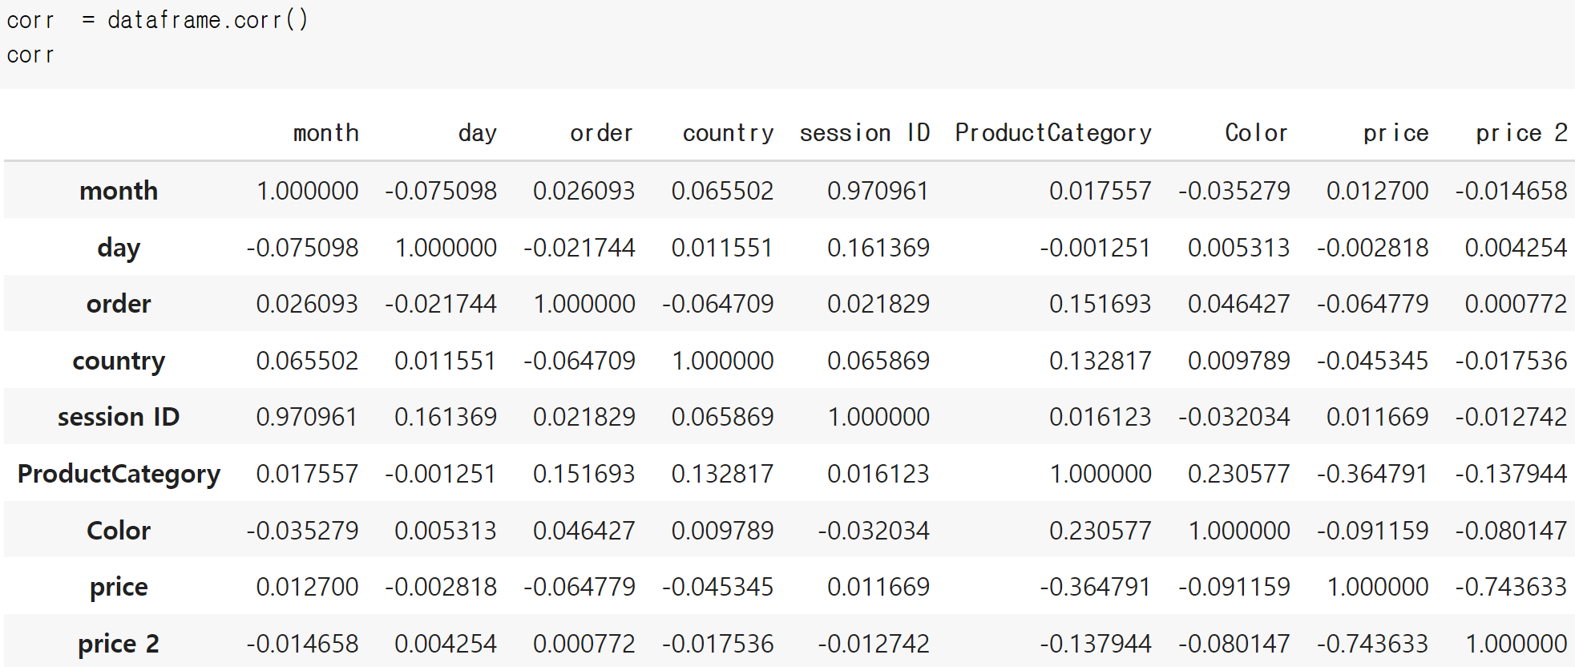
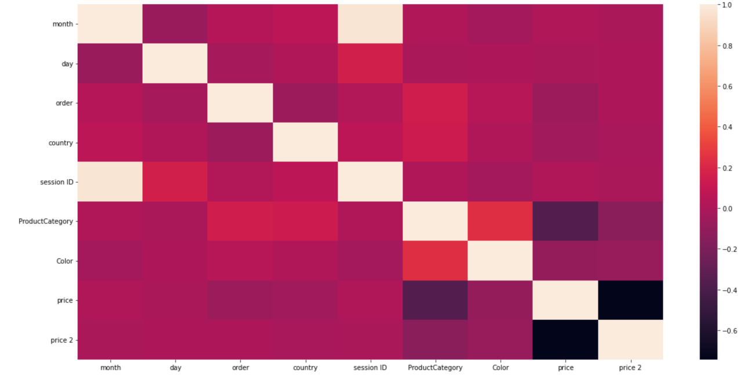
Correlation of attributes
Strongest correlation we see are the following:
Session ID and Month : 0.970961
Color and ProductCategory : 0.230577
Session ID and day : 0.161369

Slide 9
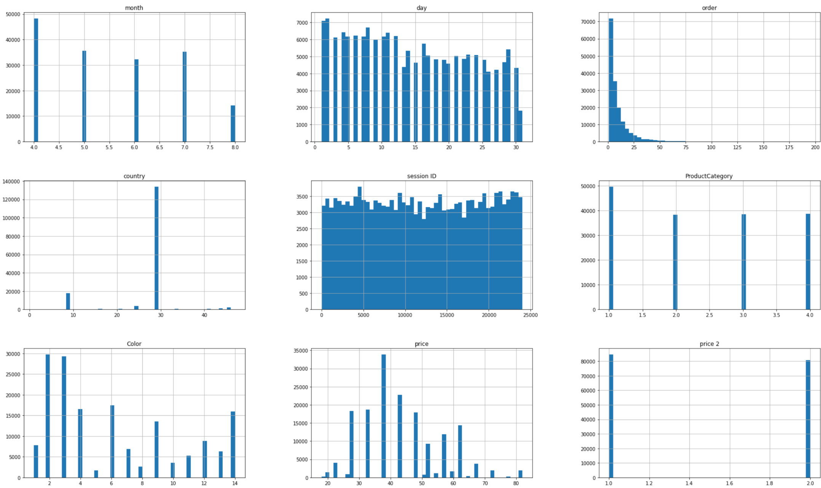
Histogram

Slide 10
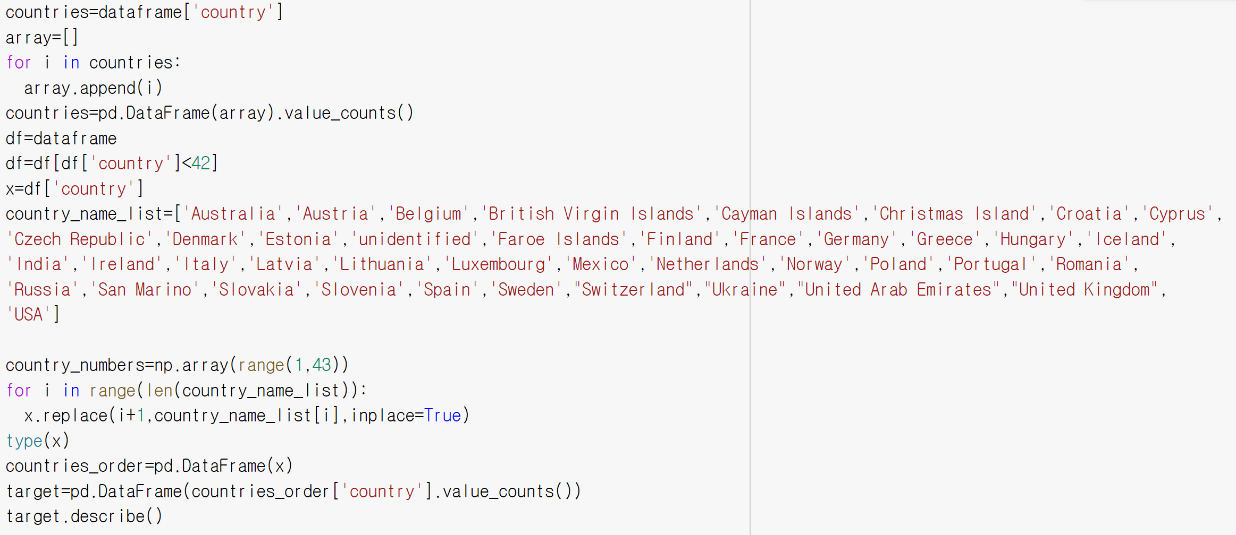
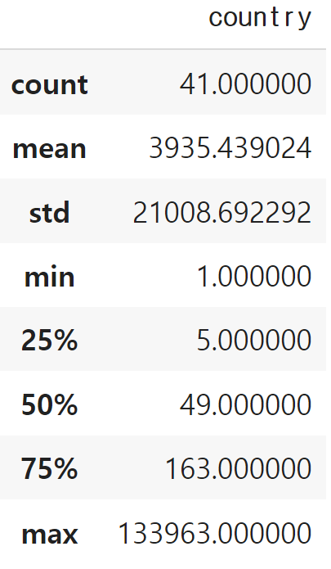
Looking at the statistic , it is worth to mention few facts which make some new insight about the data. The minimum number of clicks for a country is 1 and maximum number of clicks is 133,963.
Furthermore by considering minimum and maximum clicks from the above frame , we see a big standard deviation which shows the big gap among different countries.

Slide 11
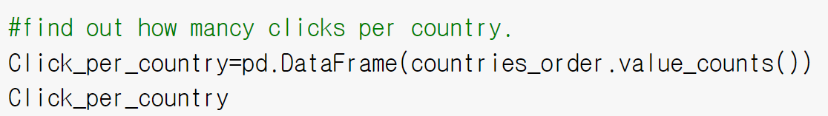
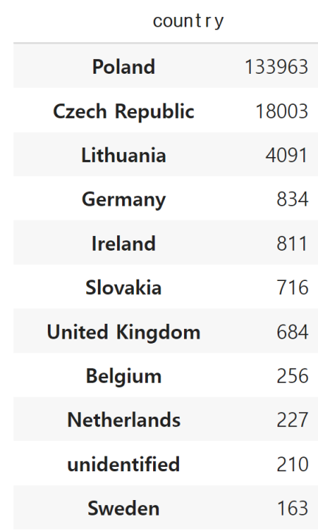
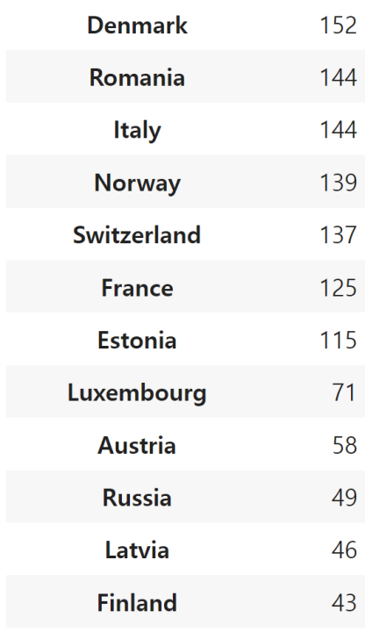
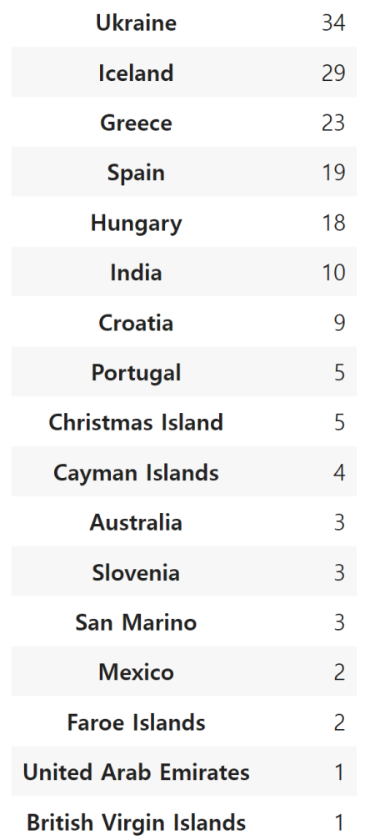
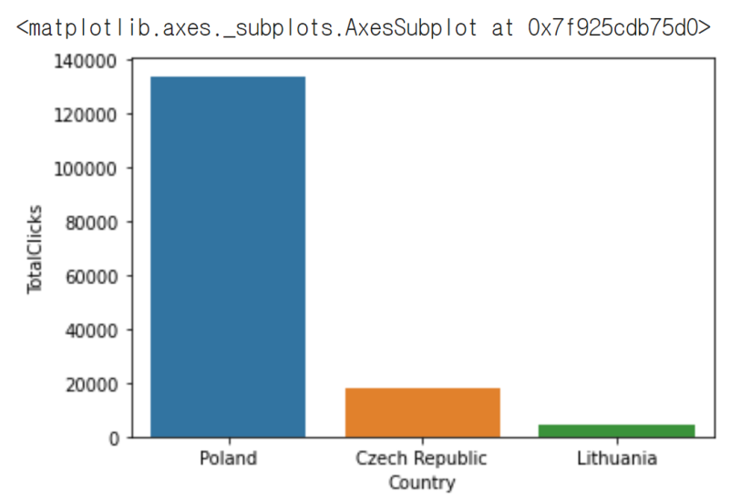
Top 3 Countries Order

Slide 12
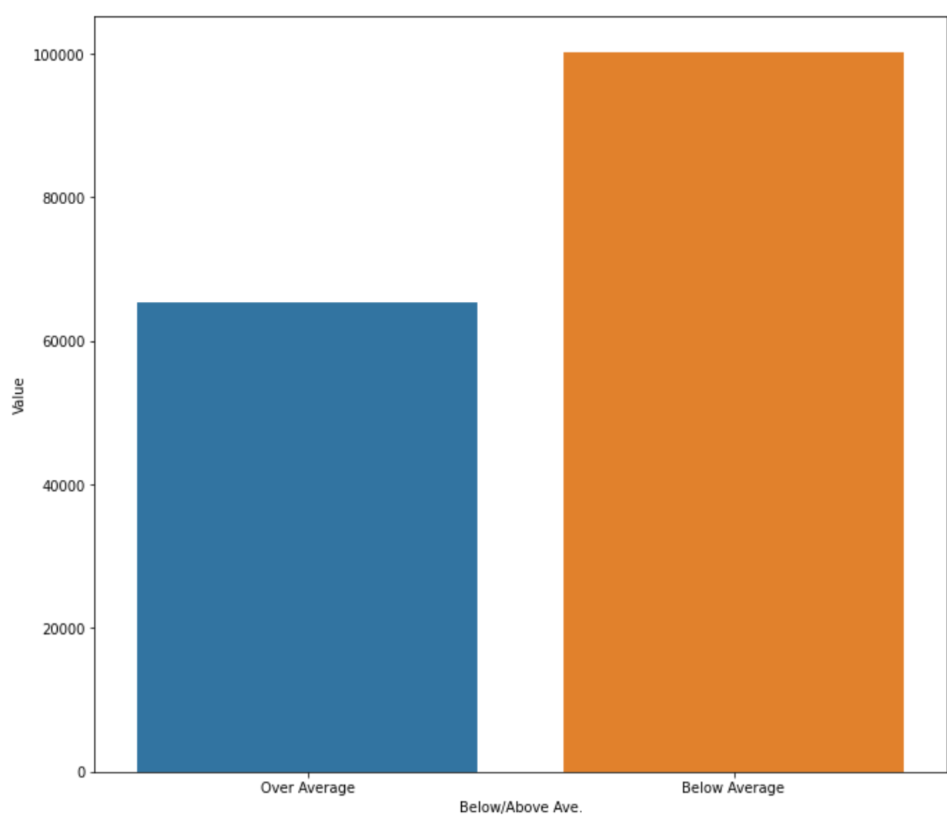
Average and values
Less than 70,000 values are over average.
Almost 100,000 values are below average.

Slide 13
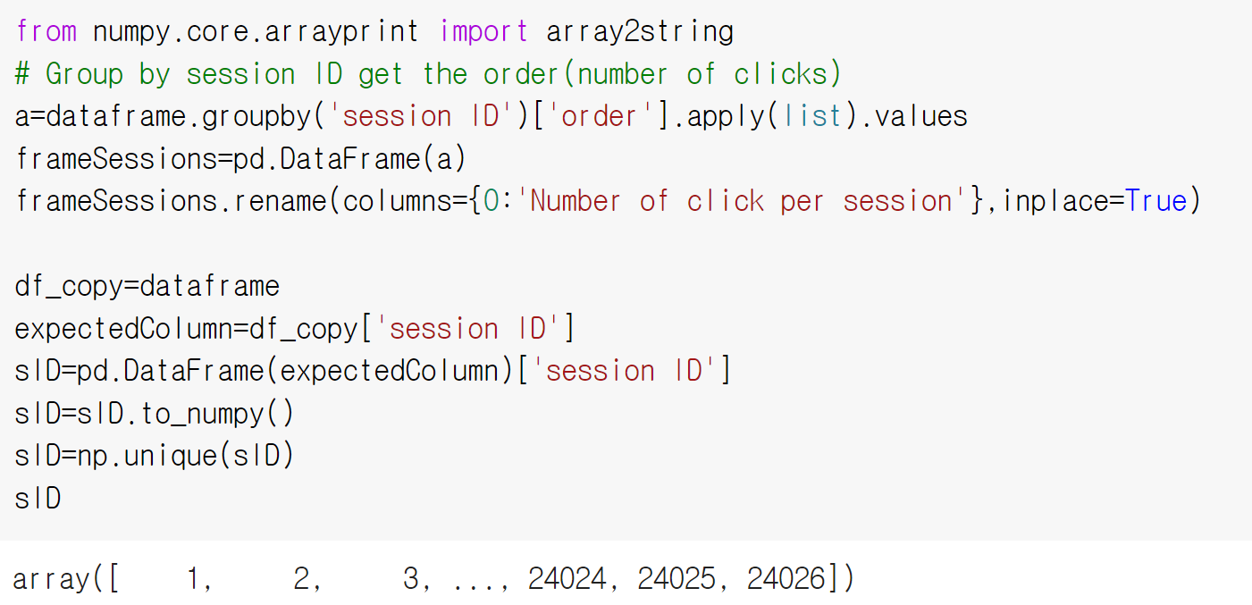
Group by session ID get the order (number of clicks)
This tables shows the interact/number of clicks a user does per session , he has came on to the e-shop to check out different
output

Slide 14
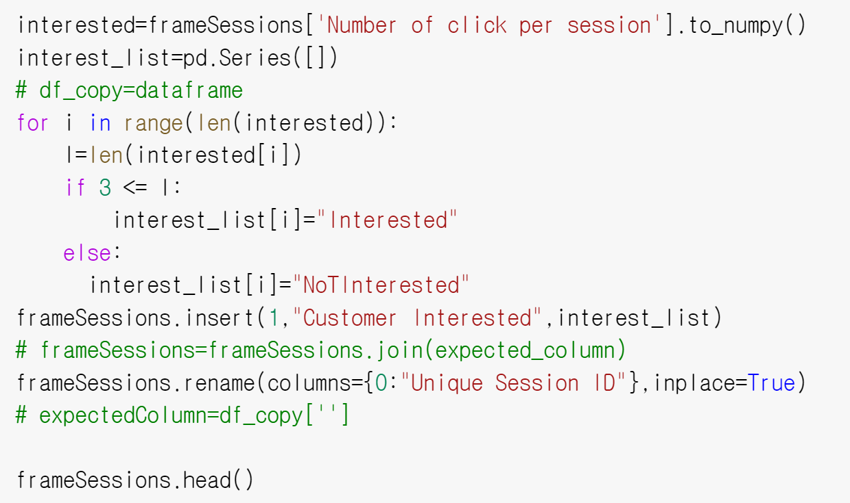
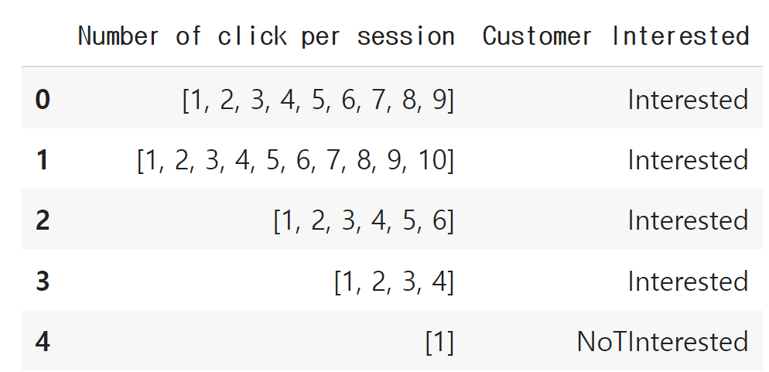
3 Click Interest Rule
We are assuming that if the user has click at least 3 times, she has some interest about some item. So , we try to look make a new category to see how many users are interested in the e-shop .

Slide 15
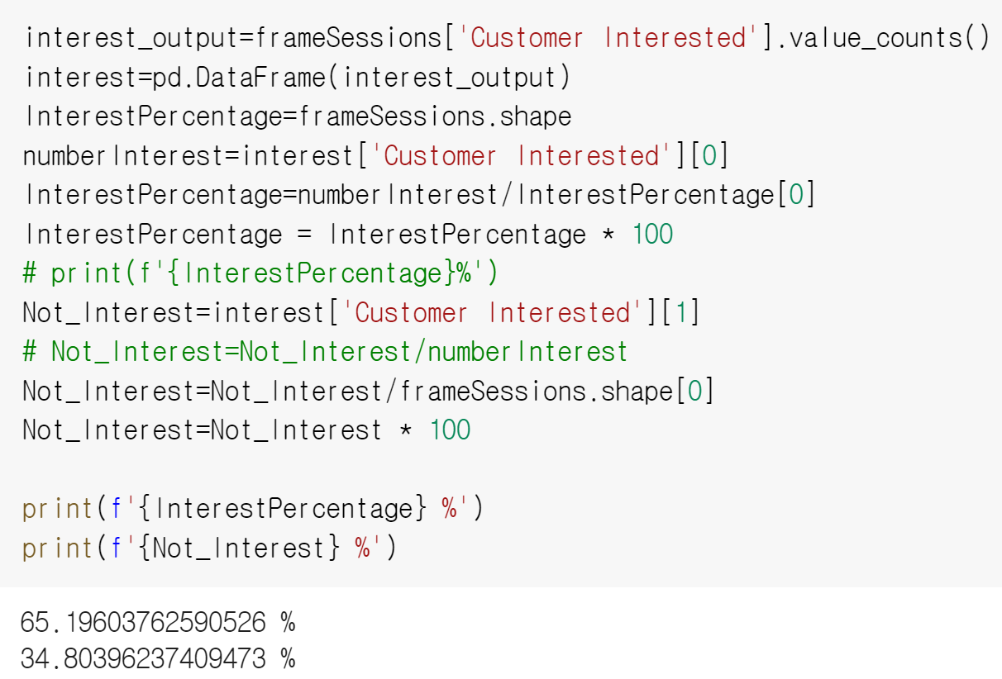
Session visit and interested or not interested
After the calculation , we could see that 65% of the session visit would be considered as "interested visit" and 34% of visits are from "Not Interested" customers visiting.

Slide 16
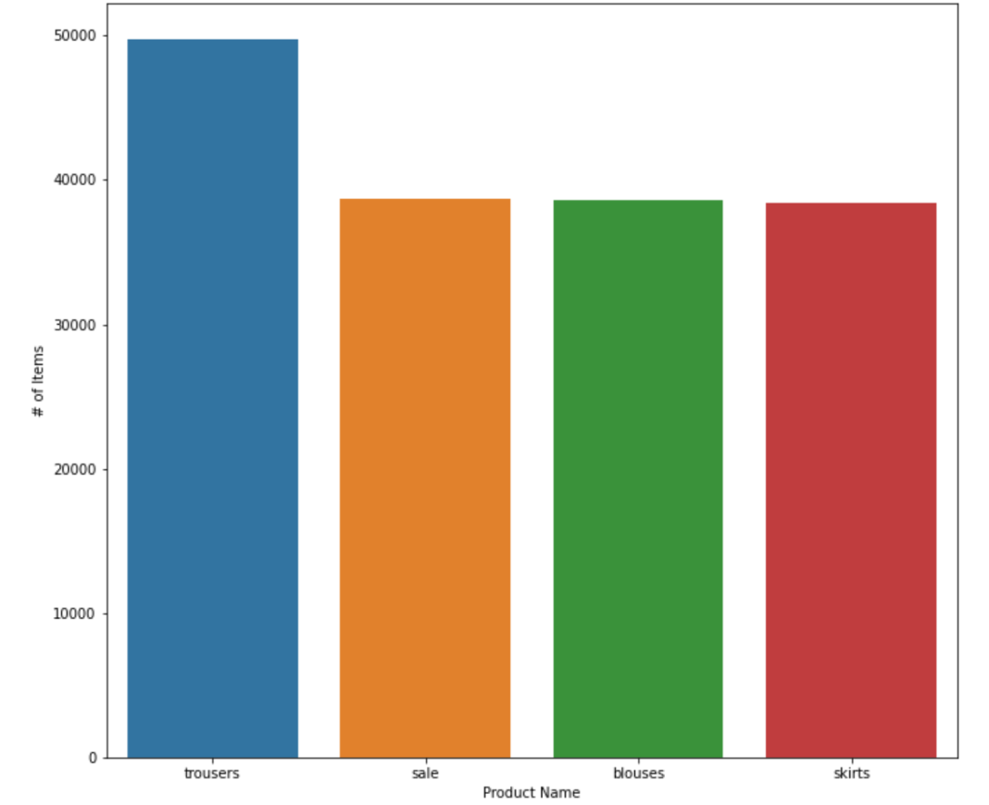
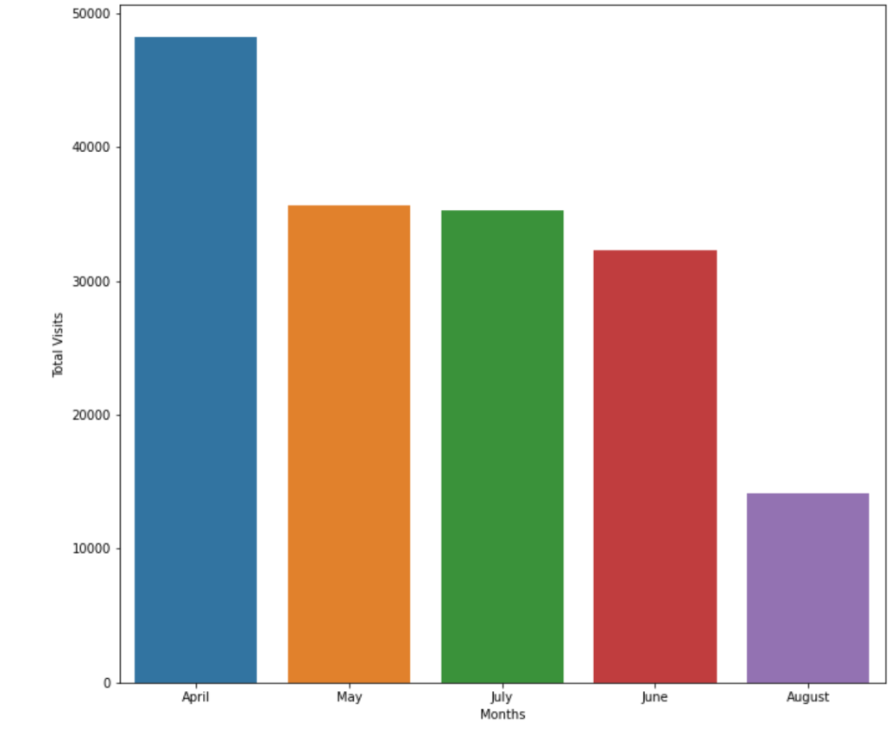
Trouser has higher number of items
April has higher number of visits.

Slide 17
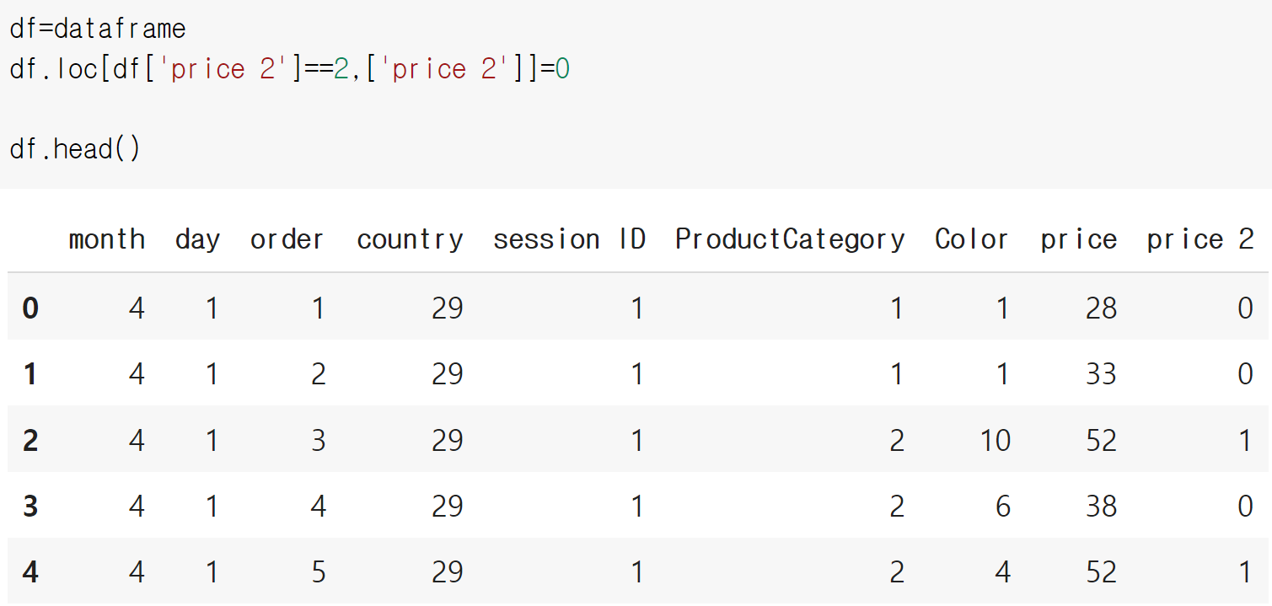
Data preparation
Dropping the clothing mode.
Changing 2's in 'price 2' into 0 to prepare for logistic regression.

Slide 18
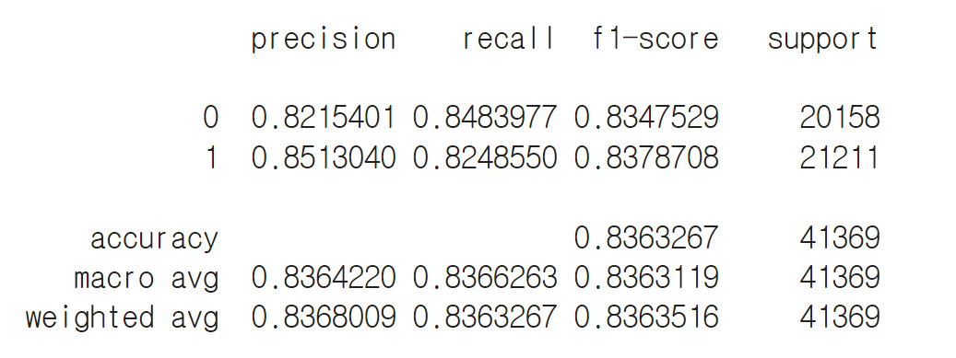
Precision, recall, f1-score
Model 1
There has 83%.

Slide 19
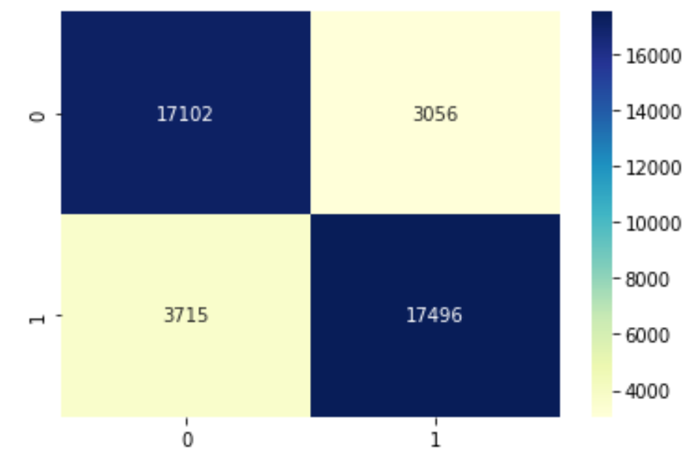
Confusion Matrix
0: No - Higher than average
1: Yes- Higher than average
True positive: 17,496
True Negative: 17,102
False Negative: 3056
False Positive:3715

Slide 20
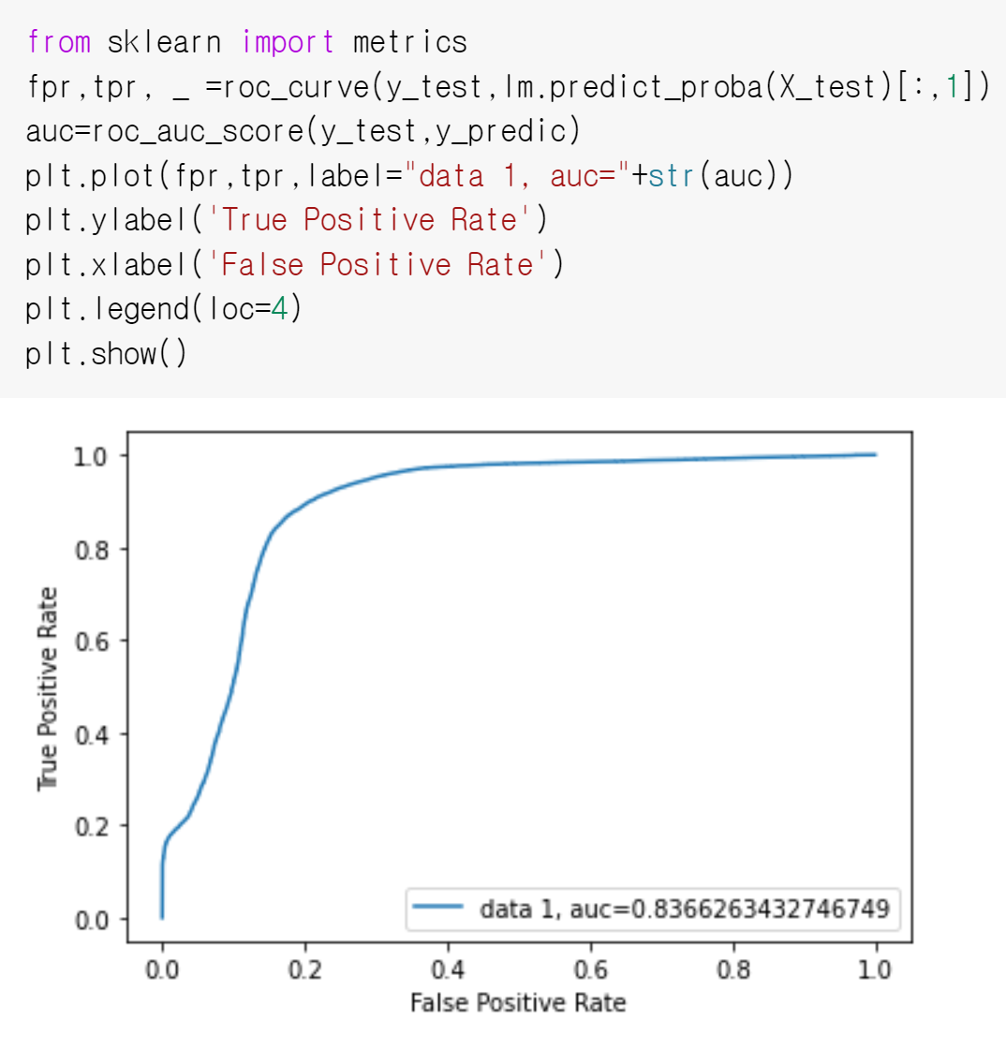
ROC Curve
Interpretation:
84% of the data can be explained with the current model.

Slide 21
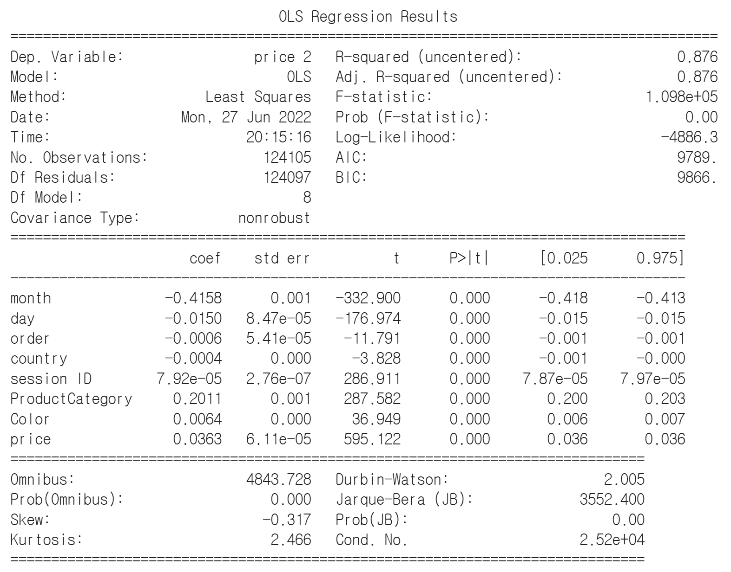
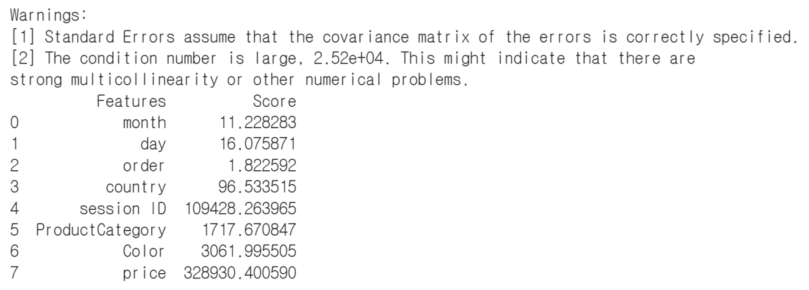
Least Squares Method (Model 2)
Sometimes the statistical softwares display the p- value as 0, depending on the settings concerning the numbers of digits to be displayed. Anyway, if your software displays a p-values of 0, it means the null hypothesis is rejected and your test is statistically significant (for example the differences between your groups are significant).
(https://www.researchgate.net/post/p_value_of_0000#:~:text=Anyway%2C%20if%20your%20software%20displays,between%20your%20groups%20are%20significant)

Slide 22
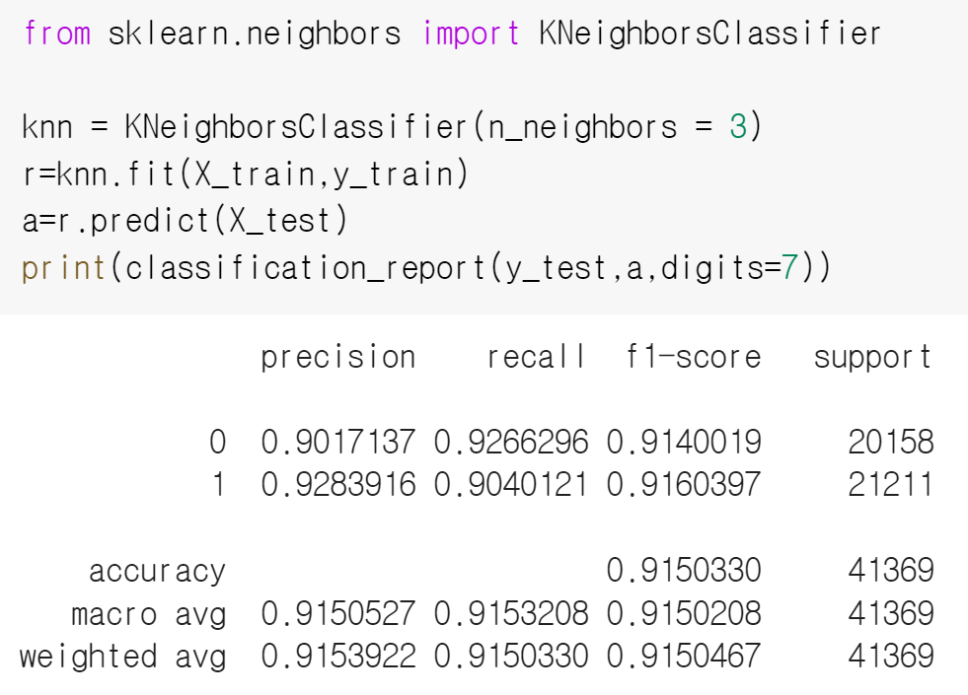
KNN Model
Improve to 92%.

Slide 23
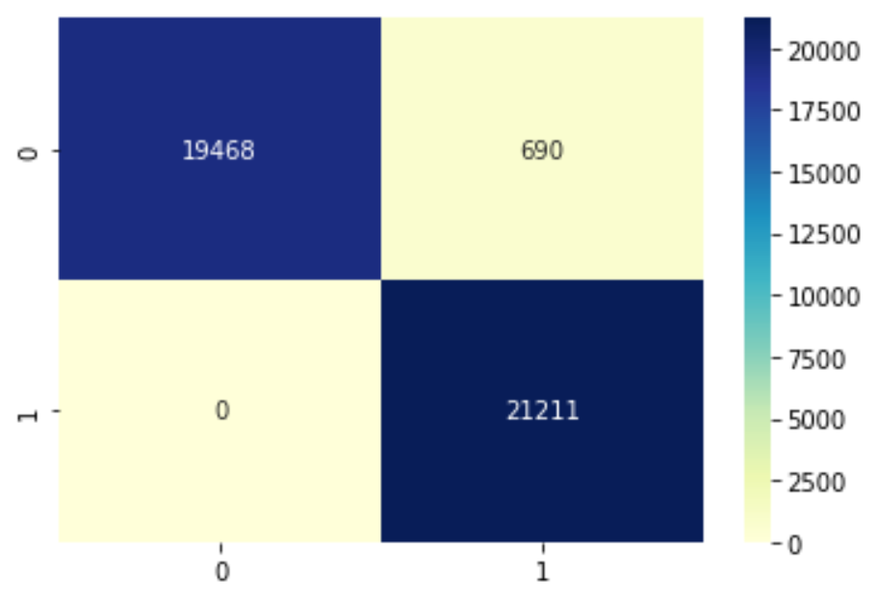
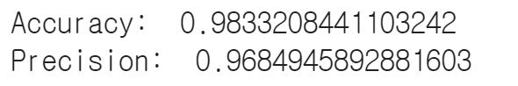
Tree Classification Model/decision tree
0: No - Higher than average
1: Yes- Higher than average
True positive: 21,211
True Negative: 19,468
False Negative: 690
False Positive:0

Slide 24


